Slide 1

Latent Conditions :
Site Investigation and Dispute Avoidance

Slide 2


Risk of Latent conditions
In Jail or Get Out of Jail Free

Slide 3
Project Development

Slide 4
Site Investigation Budget versus Risk cont’d
Type of Information provided to contractors | Average Claim Value / Contract Value
Minimal investigation no samples or test results | 15-25%
Sparse information (1980's standard) borelogs with limited interpretative content | 10-12%
Comprehensive investigation/design information & test results, no geotechnical model | 2 - 2.5%
Comprehensive investigation/design information, detailed geotechnical model | <0.1%
Source : Roads & Traffic Authority, NSW

Slide 5
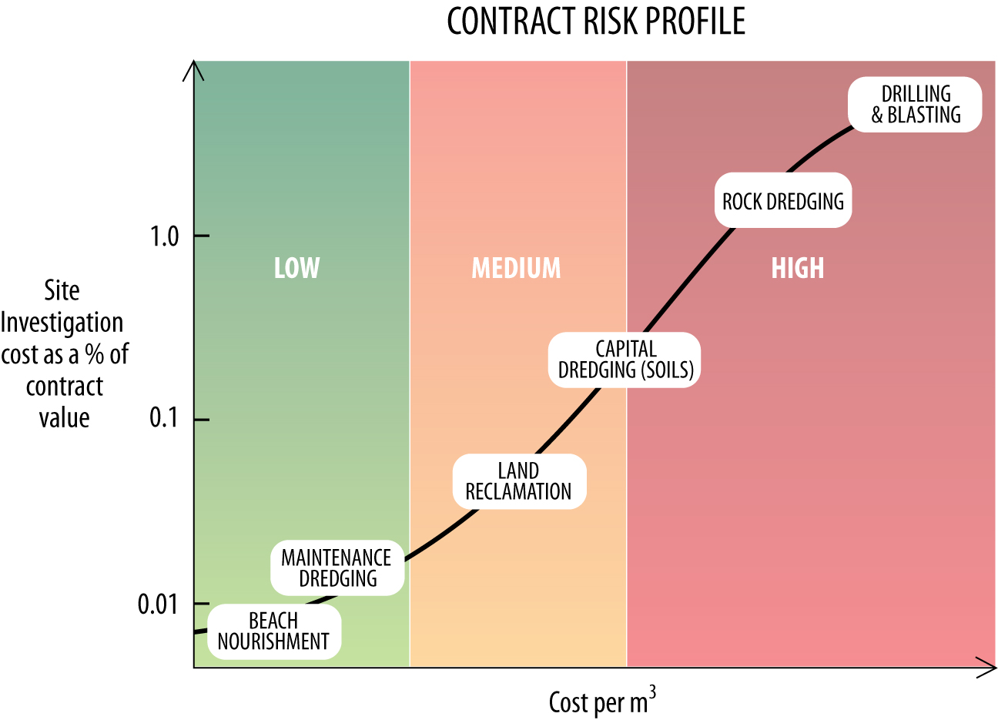
Site Investigation Budget versus Risk

Slide 6
Contractor’s Site Inspection
If the Contractor had:
(i) examined all information made available in writing by the Principal to the Contractor for the purpose of tendering; and
(ii) examined all information relevant to the risks, contingencies and other circumstances having an effect on the tender and obtainable by the making of reasonable enquiries; and
(iii) inspected the Site and its surroundings;
(Australian Standards Clause 12.1)

Slide 7
Visual Site Inspection

Slide 8
Basic parameters required for dredging
APPLICATION | CLAY | SAND, SILT OR GRAVEL | ROCK
Excavation (methods & production) | - General description - Grain size - Organic content - Gas content Total unit weight Atterberg (plastic/liquid) - Water content - Undrained shear strength | - General description - Grain size - Angularity - Carbonate content - Maximum and minimum densities | - General description - RQD - Water absorption - Total unit weight - weight of solid blocks - UCS - Mineralogy
Transport (methods & production) | - Organic content - Gas content - Particle unit weight - Atterberg (plastic/liquid) - Water content - Undrained shear strength | - Grain size - Maximum and minimum densities - Particle unit weight - Mineralogy | - weight of solid blocks - UCS - Mineralogy
Abrasion with excavation and transport | - Grain size of coarse-grained minor constituents - Mineralogy of coarse-grained minor constituents | - Grain size - Angularity - Particle unit weight - Mineralogy | - weight of solid blocks - UCS - Mineralogy

Slide 9
Typical types of Latent Conditions
Anthropogenic | Geological / Physical | Natural / Hydrological Event
Debris, wires, etc. | Cobbles, boulders | Flash flooding
Ship wrecks | Rock/Cap rock | Earthquake
Submarine Cables | UCS | Liquefaction
Pollutants | RQD/Fracture Index | Mudflows
Unexploded Ordnance | Carbonate Content | Scour
Pipelines | Mineralogy | Coastal Erosion
 | Particle Size
 | ASS or H2S

Slide 10
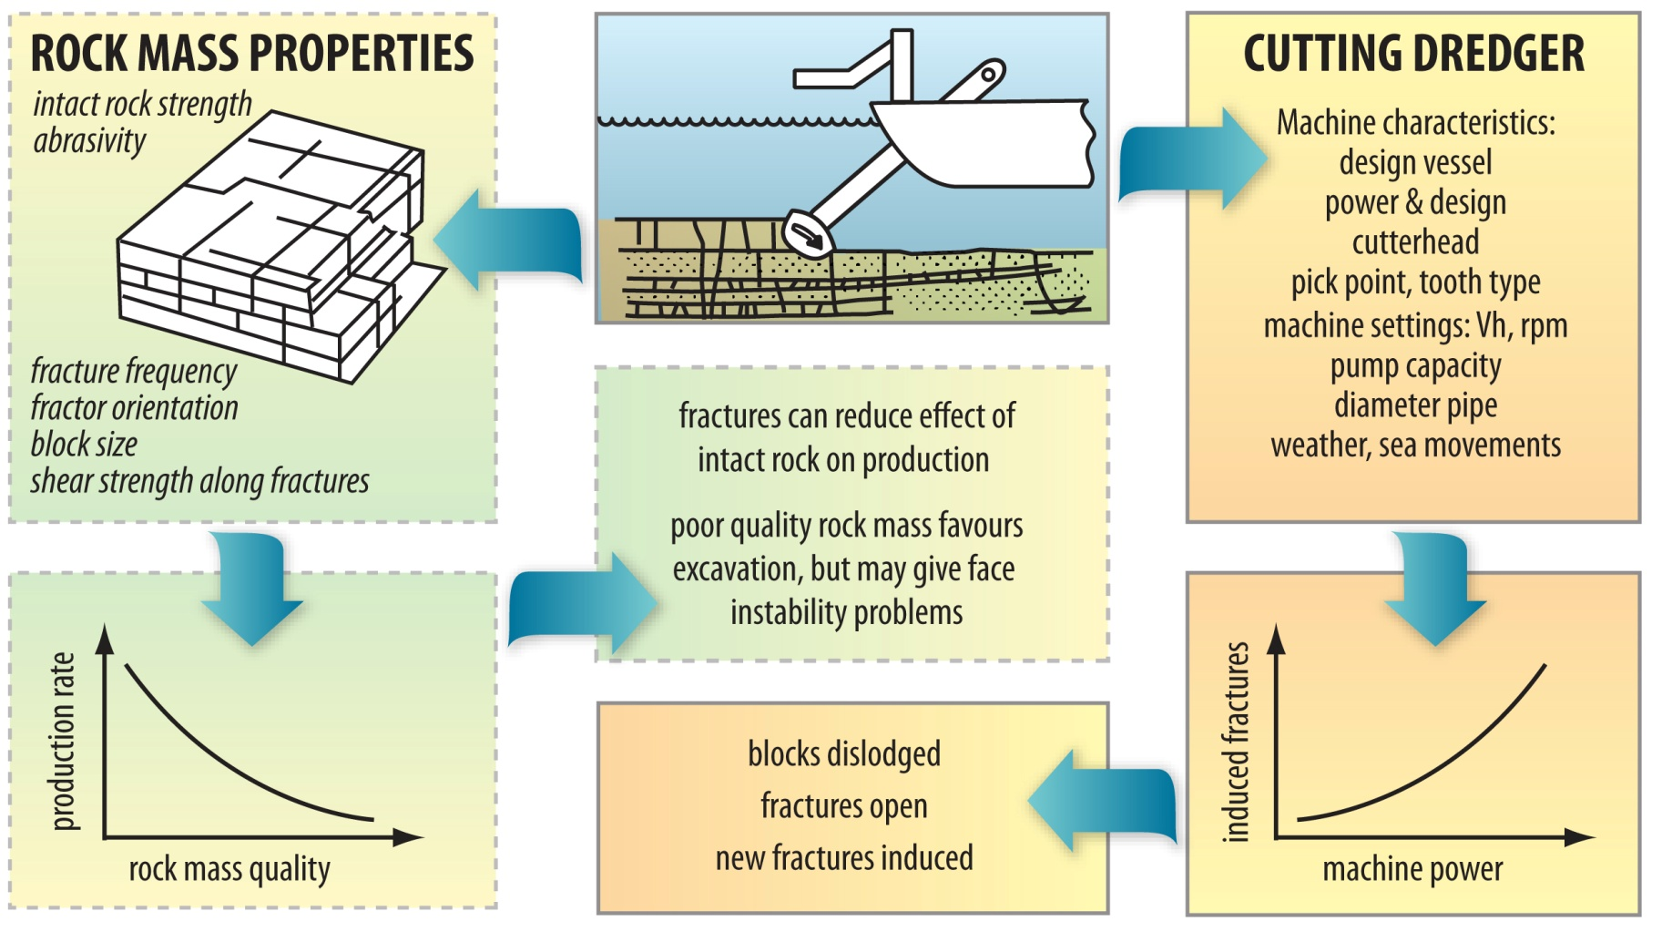
Considerations in Rock Dredging
(Verhoef), 1997

Slide 11
Contractor’s Assessment of Principal’s Site Investigation
FACTUAL | INTERPRETATION | OPINION
Exploration locations Outcrop locations, samples and cores available for inspection Bore Logs and description of soils and rocks with lithological names. Raw seismic data Visual, In-situ and laboratory test results | Inferred stratigraphy between boreholes Properties of various layers Seismic interpretation yielding velocity and layer depths 3D geotechnical model | Ease of excavation Equipment needed (type and size) Excavation stability Possible re-use of material Bearing capacity Subsoil stability Settlements

Slide 12
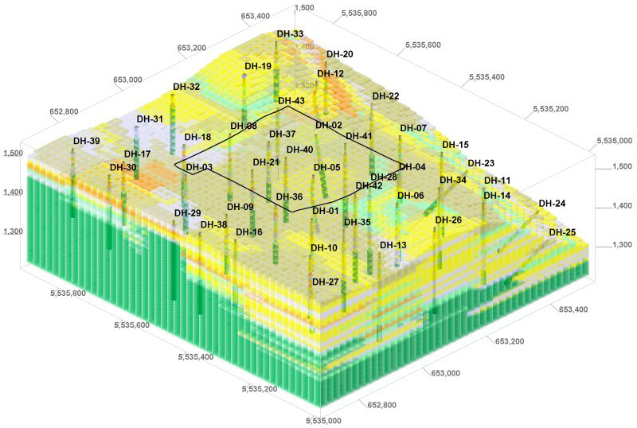
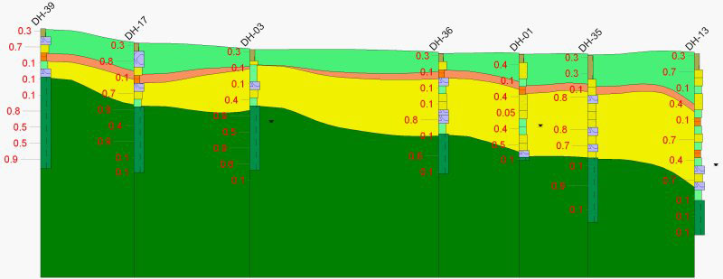
Preparing a Geotechnical Model
Increasingly Sophisticated
Software is becoming available

Slide 13
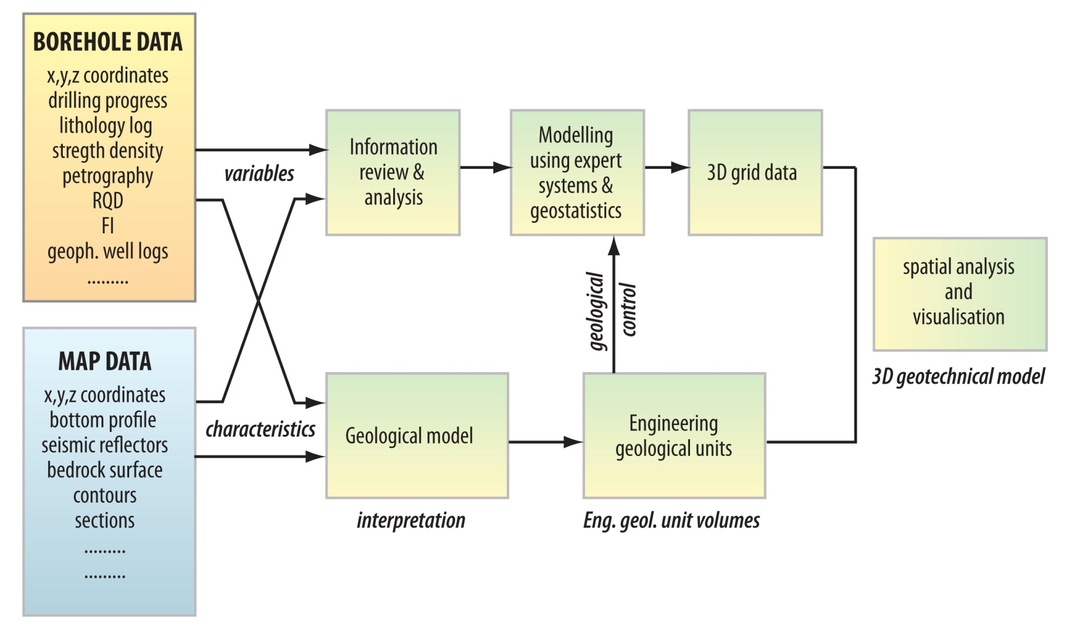
Borehole & Geophysical Data
(Verhoef), 1997

Slide 14
Australian Standards – Latent Conditions
Latent Conditions are:
(a) physical conditions on the Site or its surroundings, including artificial things but excluding weather conditions, which differ materially from the physical conditions which should reasonably have been anticipated by the Contractor or a person experienced and competent in carrying out work of the type with which the Contract is concerned, at the time of the Contractor's tender if the Contractor had:
  (i) examined all information made available in writing by the Principal to the Contractor for the purpose of tendering; and
  (ii) examined all information relevant to the risks, contingencies and other circumstances having an effect on the tender and obtainable by the making of reasonable enquiries; and
  (iii) inspected the Site and its surroundings; and
(b) any other conditions which the Contract specifies to be Latent Conditions
AS 2124 dates from 1978. AS 4000-1997 uses virtually identical wording

Slide 15
Definition of a material difference?
Roukema, 2010

Slide 16
FIDIC 1999 Contracts Clause 4.12
Contractor has based the Contract Amount on the Site Data.
If the Contractor encounters adverse physical conditions which are Unforeseeable entitled to EOT and Cost.
"physical conditions" means natural physical conditions and man­made and other physical obstructions and pollutants, which the Contractor encounters at the Site when executing the Works, including sub-surface and hydrological conditions but excluding climatic conditions.
"Unforeseeable" means not reasonably foreseeable by an experienced contractor by the date for submission of the Tender.

Slide 17
NEC 3 Contract
Entitlement to compensation if the Contractor encounters physical conditions which :
- are within the site
- are not weather conditions, and
- which an experienced contractor would have judged at the Contract Date to have ‘such a small chance of occurring that it would have been unreasonable for him to have allowed for them’.

Slide 18
Dispute Avoidance / Management
Early Contractor Involvement
Risk Register
Establish Geotechnical Reference Conditions
Dispute Review Board

Slide 19
Geotechnical Reference Conditions
Establish baseline & boundary conditions to define what is a Latent condition, not dredgeable or outside the basis of pricing;
Parties are clear as to the allocation of risk in the project;
Avoids the subjective assessment of what should have been anticipated and disputes in interpretation of a ‘Latent Condition’

Slide 20
Further Reading
‘Adverse Physical Conditions and the Experienced Contractor ‘
author - David Kinlan
To be published by Delft Academic Press due for release in mid 2014

